Slide 1

CLUSTERING PARKING METER ZONE

Slide 2
Parking meter zone.
Parking meter zone has only one price.
Find the best cluster for offer 3 different prices.

Slide 3
Data
Our data is from December to now with every parking meter transaction. (277544 rows x 29 columns)
Parking meter location data
For analysis, I decided to sum each transaction import and count how many transaction for each parking meter.
Combine data location and the new cleaned data is 196 rows × 4 columns.

Slide 4
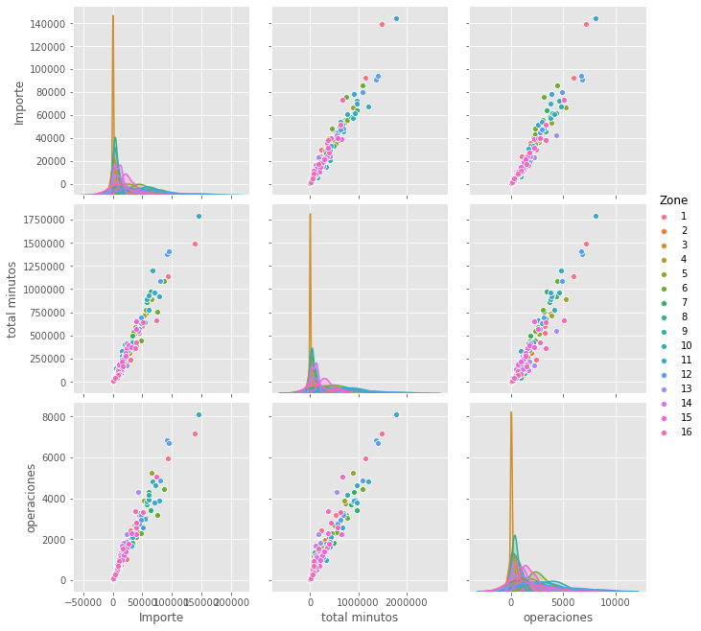
correlation
There is not relation between our features

Slide 5
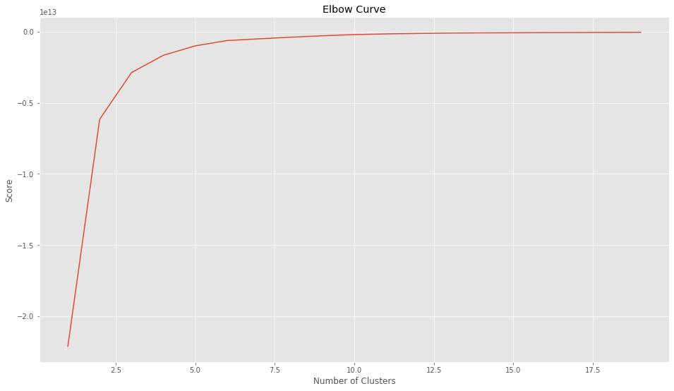
K-means
Lets fin k-values for this project but I need 3 different zones for my project.
Elbow curve method indicates 3 is a good option for me.

Slide 6
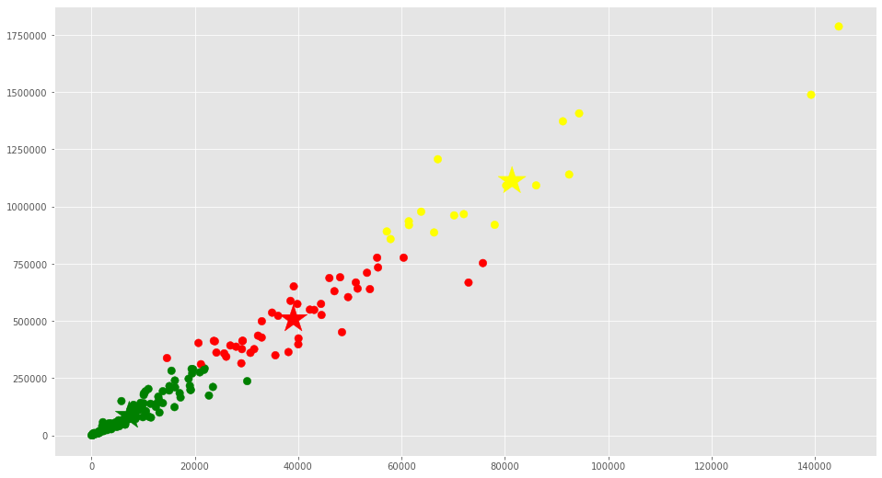
K-MEANS RESULT
According to result we can cluster our parking zone in three different zone

Slide 7
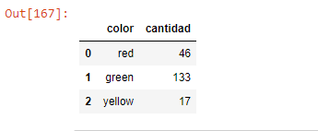
Cluster elements
Total of element for each cluster

Slide 8
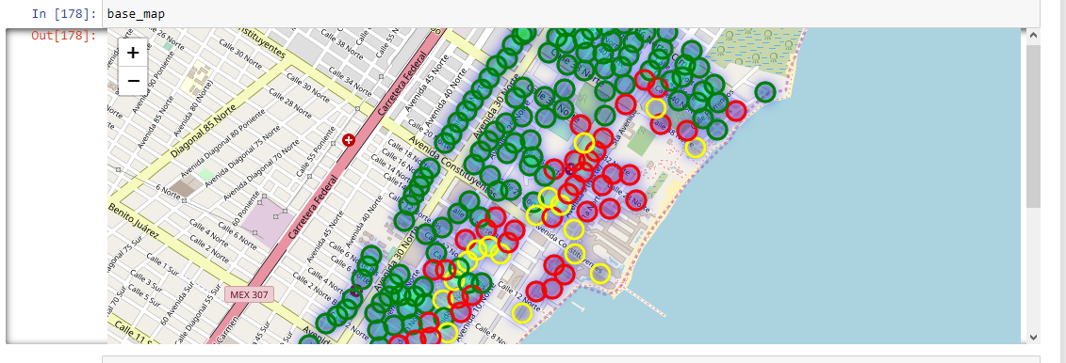
New map zone
Parkin meter zone with clusters

Slide 9
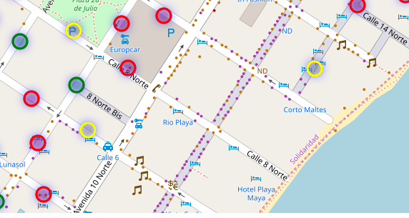
conclusion
My principal purpose with this algorithm was clustering my parking meter zone for adjust my price into three new prices. (workers, tourist, residents)
After to view results on map, I can identify another situation, some parking meters with less use are close or into the zone with high demand parking meter, this new view is for adjust location or investigate if there is an incident with useless parking meter.
I pretend to re-use this algorithm for new analysis for this project, with more data records and compare if there’s another import feature for analysis.

